Slide 1
SEIZURES IN CHILDREN

Slide 2
Outline
Definition/ Introduction
Aetiology
Classification
Clinical features
Investigations
Treatment
Differential diagnosis
Febrile seizures
Neonatal seizures

Slide 3
SEIZURES IN CHILDREN
Definition
Epileptic seizure: paroxysmal involuntary disturbance of the brain function.
Clinical features include an impairment (or loss) of consciousness, abnormal motor activity, behavioural abnormalities, sensory disturbance or autonomic dysfunction.

Slide 4
SEIZURES IN CHILDREN
Seizure may result from enhanced:
  neuronal discharge of a given focus.
  transmission of normal/abnormal discharge.
Convulsion: an epileptic seizure characterised by motor activity.
Epilepsy: two or more recurrent unprovoked seizures.

Slide 5
SEIZURES IN CHILDREN
Epilepsy syndrome: a clinical entity of relatively consistent clinical features.
The features are:
  seizure type(s),
  aetiology,
  EEG features,
  neurologic status,
  prognosis, and/or,
  response to specific antiepileptic drugs.

Slide 6
Aetiology of Seizures:
1. Metabolic disorders
  Hyperglycaemia
  Hyponatraemia
  Hypoglycaemia
  Hypernatraemia
  Hypomagnesaemia
  Hypocalcemia.

Slide 7
Aetiology of Seizures:
2. Infections
  Meningitis
  Encephalitis
  Abscess
  Septicaemia
  Parasitic infestations like Malaria.

Slide 8
Aetiology of Seizures
3. Tumours / intracranial SOL
  Malignancies: Primary/ secondary
  Cystic lesions e.g. Hydatid cyst, cysticercosis
  Others e.g. Foreign Bodies, inflammatory lesions, effusions

Slide 9
Aetiology of Seizures
4. Inherited conditions
  Storage diseases
  Metabolic diseases e.g. porphyrias
  Deficiency e.g. pyridoxine dependency
  Neurocutaneous disorders e.g. Tuberous sclerosis, neurofibromatosis etc.

Slide 10
Aetiology of Seizures
5. Systemic disorders
  Vasculitis
  Encephalopathy of hypertension
  Renal failure
  Hepatic failure
6. Drugs
  Lead
  Addictive drug withdrawal
  Alcohol withdrawal.

Slide 11
Aetiology of Seizures
7. Toxins
  organophosphates,
  carbamates.
8. Trauma to the head
  concussion,
  contusion.

Slide 12
Aetiology of Seizures
9. Disorders of neurodevelopment
  Neuronal/ neuroblast migration disorders
  Dysplasias
  Dysgenesis
10. Idiopathic.

Slide 13
SEIZURE CLASSIFICATION.
1. Partial seizure (focal or localised)
(A) Simple Partial seizures
  With motor signs.
  With somatosensory or special sensory systems.
  With autonomic symptoms or signs.
  With psychic symptoms.

Slide 14
SEIZURE CLASSIFICATION.
1. Partial seizure (focal or localised)
(B) Complex partial seizures
  Simple partial at onset followed by impairment of consciousness
  With impairment of consciousness at onset

Slide 15
SEIZURE CLASSIFICATION.
1. Partial seizure (focal or localised)
(C) Partial seizure evolving to secondarily generalised seizures
  Simple partial seizures evolving to generalised seizure
  Complex partial seizures evolving to generalised seizures
  Simple partial seizures evolving to complex partial then to generalised seizures.

Slide 16
SEIZURE CLASSIFICATION.
11. Generalised
  Absence seizures
  Tonic clonic (grand mal epilepsy)
  Tonic
  Clonic
  Akinetic/ atonic
  Myoclonic

Slide 17
Seizures: Clinical Features
Depend on:
  the type of seizure manifested,
  the aetiology or
  the epileptic syndrome among others.
It may be generalised or localised (focal/ partial).
Associated with variable level of consciousness.
Characterised based on the classification of the International League Against Epilepsy.

Slide 18
Clinical features
1. Partial Seizures
A. Simple partial seizures
    Consciousness retained through the episode.
    Manifestation may be motor, sensory or autonomic.
    Depends on the part of the brain primarily affected.
    Precentral gyrus focus presents motor activity.
    Sensory features - Postcentral gyrus activity.
    Autonomic presentation e.g. nausea, palpitations in temporal and frontal lobes focus.

Slide 19
Clinical features
1. Partial Seizures
B. Complex partial seizures
    Associated impairment of consciousness.
    Impaired consciousness either at onset or secondary.
    Aura present (often not recognised).

Slide 20
Clinical features
1. Partial Seizures
C. Partial seizure secondarily generalised.
    Initial simple partial seizure spreads to other parts.
    Complex partial seizures evolving to generalised seizures.
    Simple partial evolves to complex partial then generalised.

Slide 21
Clinical features
2. Generalised seizures
A. Absence seizure
  Brief episodes of sudden interruption of ongoing activity, blank stare, altered tone
  associated loss of consciousness over this period
  minimal or no motor manifestation
  no memory of the event
  easily provoked by hyperventilation

Slide 22
Clinical features
2. Generalised seizures
B. Tonic clonic seizure
    Is associated with convulsion involving various muscle groups
    Generalised seizures have bilaterally synchronous onset and generalised EEG features commonly.
C. Tonic
- Sudden sustained muscle contraction.

Slide 23
Clinical features
2. Generalised seizures
D. Clonic.
    Repeated muscle jerk like activity
E. Akinetic/ atonic.
- Sudden loss of muscle tone.
- Presents like faint attack/syncope
F. Myoclonic
-Isolated muscle group jerk like epsodes.

Slide 24
Investigations
Are many and will be influenced by the differential diagnosis:
Random blood sugar
Haemogram
Blood slide for Malaria parasites
Blood biochemistry
Liver function tests

Slide 25
Investigations
Cerebrospinal fluid assay
Chemical analysis for poisoning
Skull x-ray
EEG
CT scan / MRI scan.

Slide 26
TREATMENT
Depends on the suspected cause.
Treat the primary cause.
Anti-epileptic drugs to stop the seizure.
Long-term anti seizure drugs.

Slide 27
Differential Diagnosis
Syncope / faint attack.
Psychogenic pseudoseizures.
Transient ischaemic attack.
Tics.
Breath holding attacks.
Tetany/ tetanus/ Muscular spasms.
Movement disorders.
Total global amnesia

Slide 28
Differential Diagnosis
Abdominal colic.
Narcolepsy/ cataplexy.
Sleep disorders.
Paroxysmal torticollis.
Startle disease (hyperexplexia).
Daydreaming.
Benign paroxysmal vertigo.
Migraine.

Slide 29
FEBRILE SEIZURES
Age of occurrence is 6 month to 6 years.
Always associated with fever.
Diagnosis of exclusion.
Occurs in boys more commonly than girls.
Familial association seen (Chr 19 and 8)
Usually generalised tonic clonic but can take any form.
Chances of recurrence are higher in those whose onset was at infancy.

Slide 30
Febrile Seizures
Epilepsy may develop in later life.
Status epilepticus can occur.
Complicated febrile seizures:
  are prolonged,
  focal or
  several episodes within the same illness
Exclude CNS infections like meningitis.

Slide 31
Febrile Seizures
Investigations are variable.
EEG not routine test; usually it is normal.
Treat the cause; control fever; and the convulsion.
Long term prophylaxis with Phenobarbital useful.
Prophylaxis is not mandatory (the American Academy of Paediatrics - 2001)

Slide 32
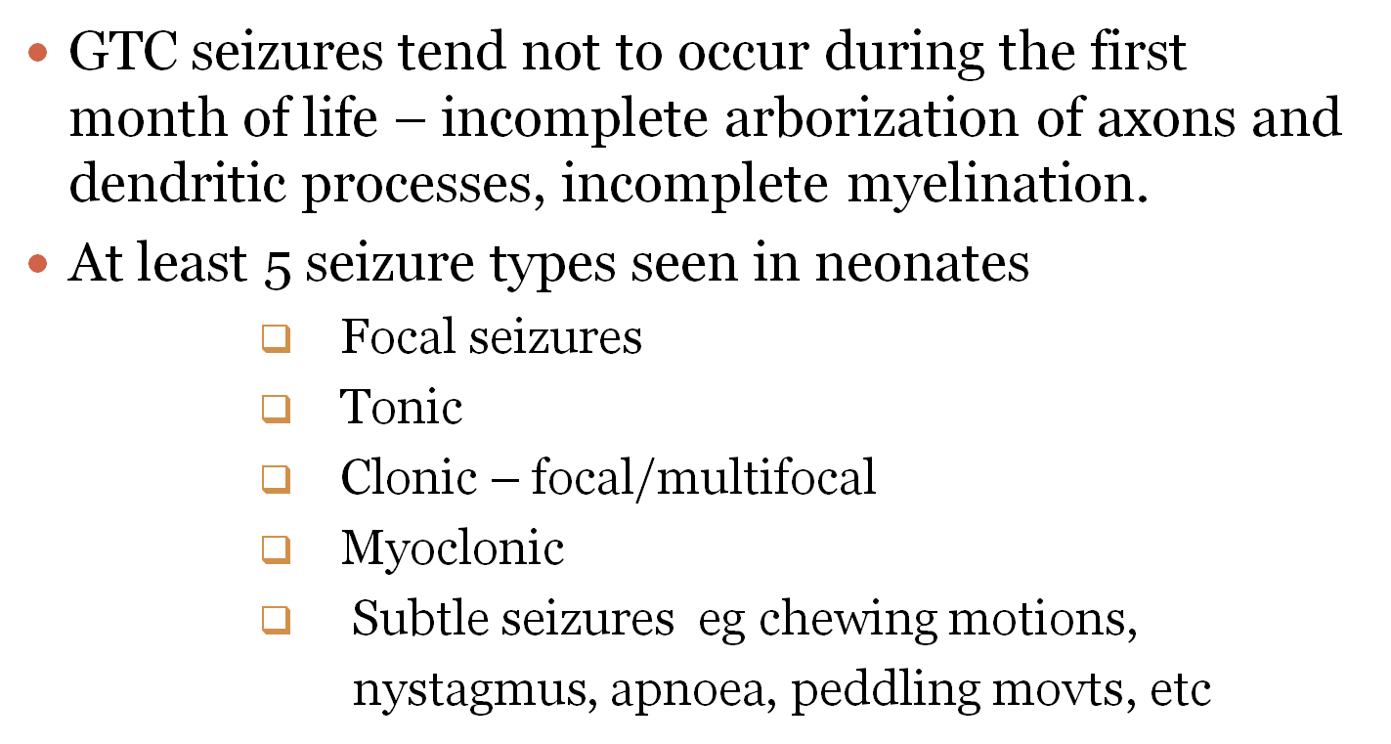
NEONATAL SEIZURES

Slide 33
NEONATAL SEIZURES
CAUSES
        Hypoxic Ischaemic encephalopathy (Birth
        asphyxia)
        Hypoglycaemia SGA, IDM
        Hypocalcaemia LBWs, IDM
        Hyponatremia / Hypernatremia
        Hypomagnesaemia

Slide 34
NEONATAL SEIZURES
        Intracranial hemorrhage – upto 15% of cases
        Infection
        Inborn error of metabolism
        Idiopathic (no cause found 10% of cases)
        Drug withdrawal
        Developmental defects
        Deficiencies eg pyridoxine
        Benign familial neonatal seizures
        Trauma

Slide 35
NEONATAL SEIZURES
Certain syndromes have seizures as part of the syndrome description eg Aicardi, incontinentia pigmenti, tuberous sclerosis
Unintentional injection of a local anaesthetic into a fetus during labour

Slide 36
Investigations
Blood Glucose
Calcium :Low Ca seen in birth trauma, CNS insult in the perinatal period, Maternal DM, Prematurity, Di George syndrome, high PO4 feedings
Magnesium
UECs
LP
Cranial US
CT Scan #Metabolic work up #EEG

Slide 37
Neonatal seizures management
ABCs to ensure adequate ventilation and perfusion
Hypoglycaemia (Dextrose 10 %)
Hypocalcaemia (Cal gluconate 10 %)
Hypomagnesaemia ( Ms So4)
Antibiotics ( If there is infection)
Correct electrolyte abnormalities
Anticonvulsants ( PB, Phenytoin, Na Valproate)
Trial of pyridoxine for refractory seizures

Slide 38
QUESTIONS?

